Slide 1
Week 10 progress report
Eunice orenge
Laban mwangi
Stephen kinuthia
Victor ngatia

Slide 2
01
Test buck converter design on breadboard.
Objectives
02
Fabricate the buck converter PCB.
01
Assist navigation team build a UI to interact with tractor.
03

Slide 3
Test buck converter design on breadboard.
After finishing purchasing all circuit elements for
fabricating the PCB we had designed , we began
the testing phase on a breadboard to ensure the
buck converter would work as expected as a PCB.
01
Our tests were successful and the buck converter’s
output voltages were as expected as shown in the
photos on the next slide.

Slide 4
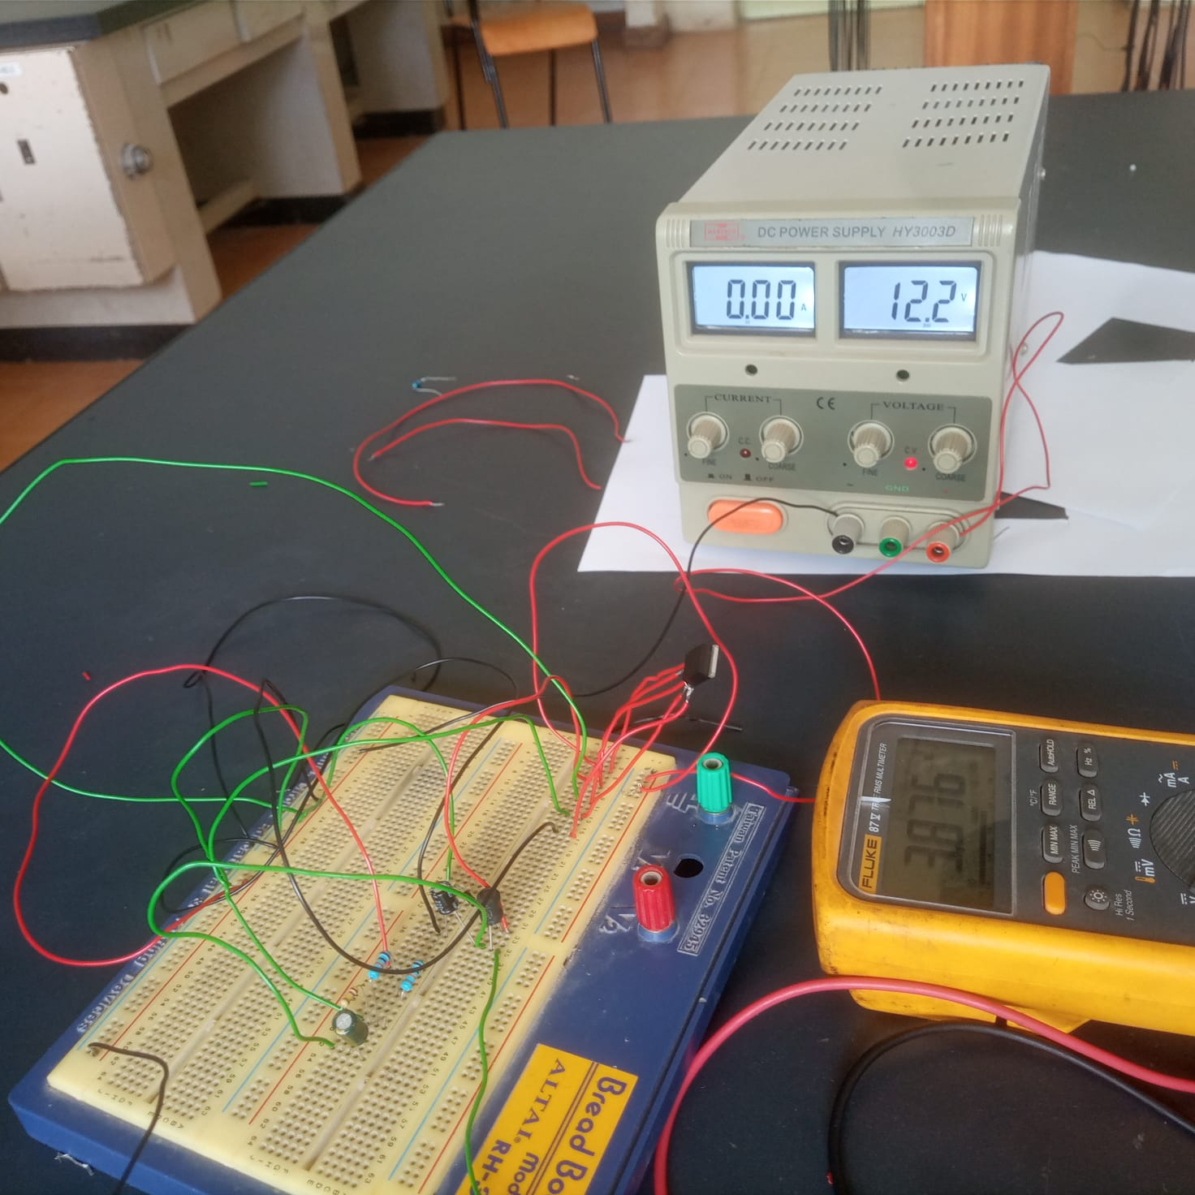
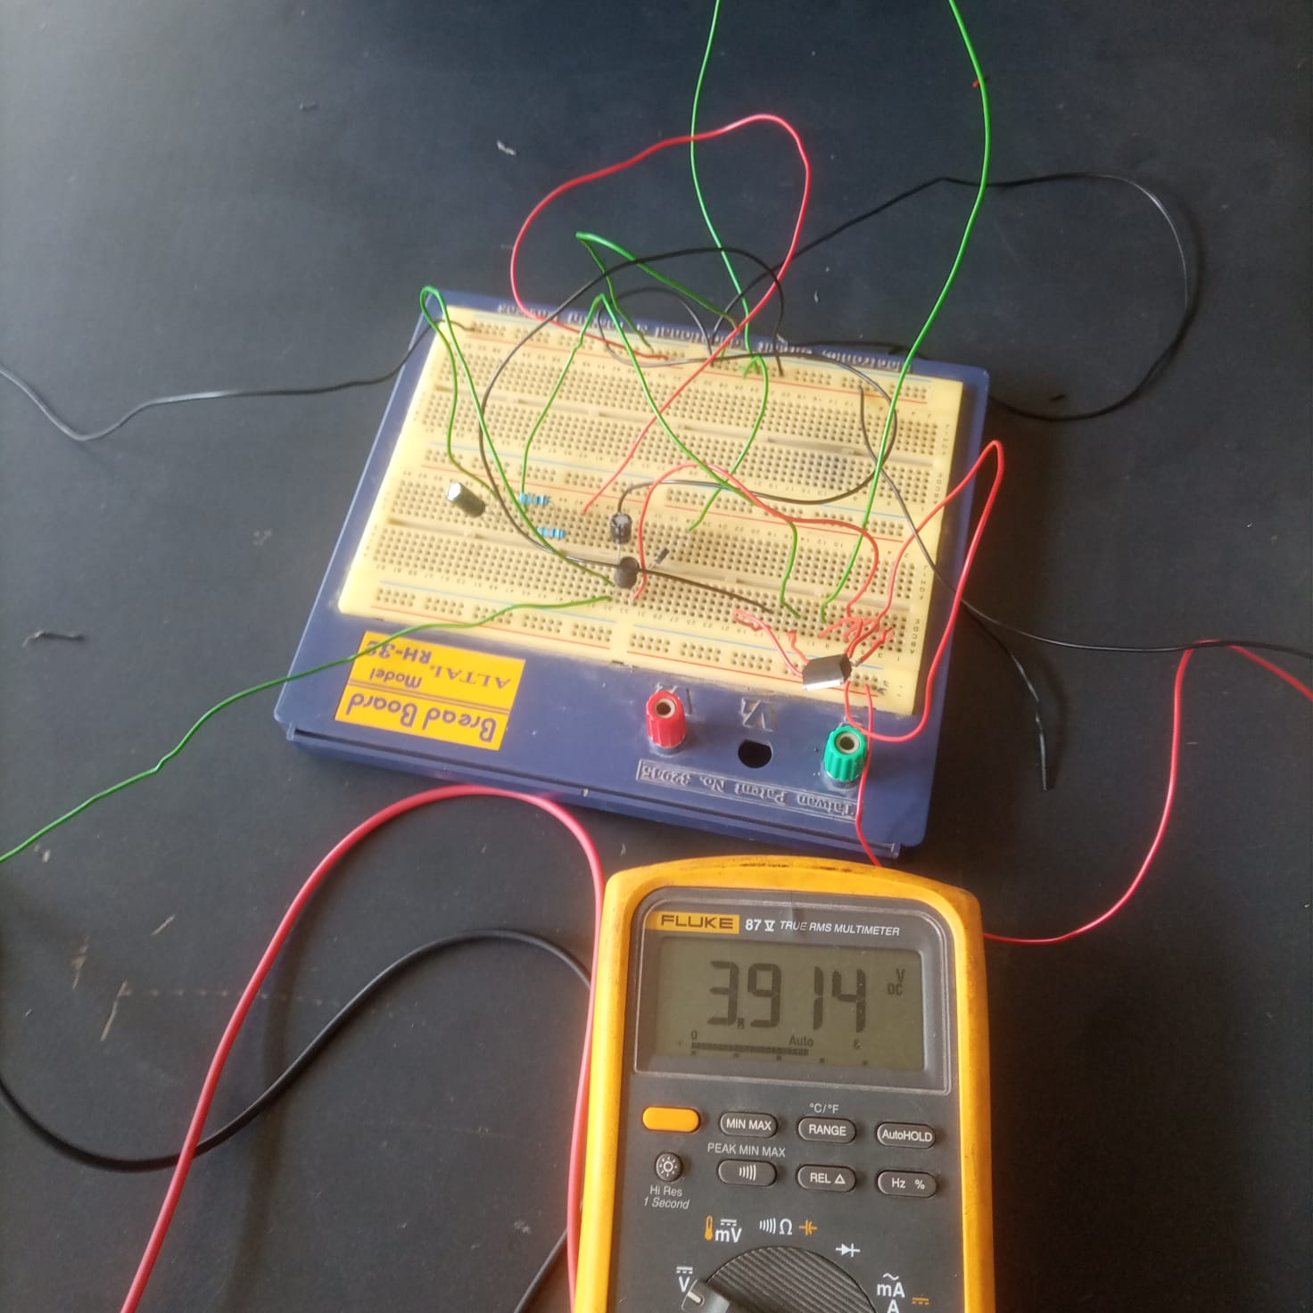
01
TESTING BUCK CONVERTER ON A BREADBOARD

Slide 5
Fabricate the buck converter PCB.
After testing the buck converter circuit on a
breadboard and getting successful results , we
began the fabricating process.
02
The fabricating process was a 7 part process
as highlighted below.

Slide 6
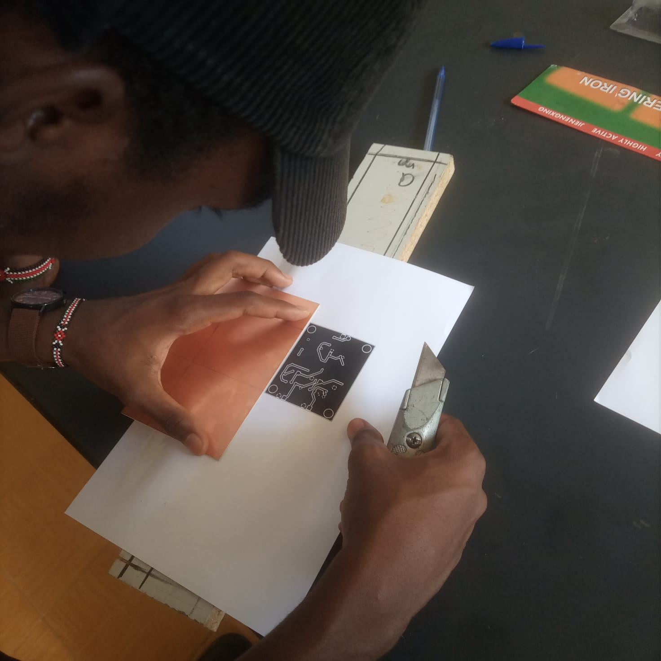
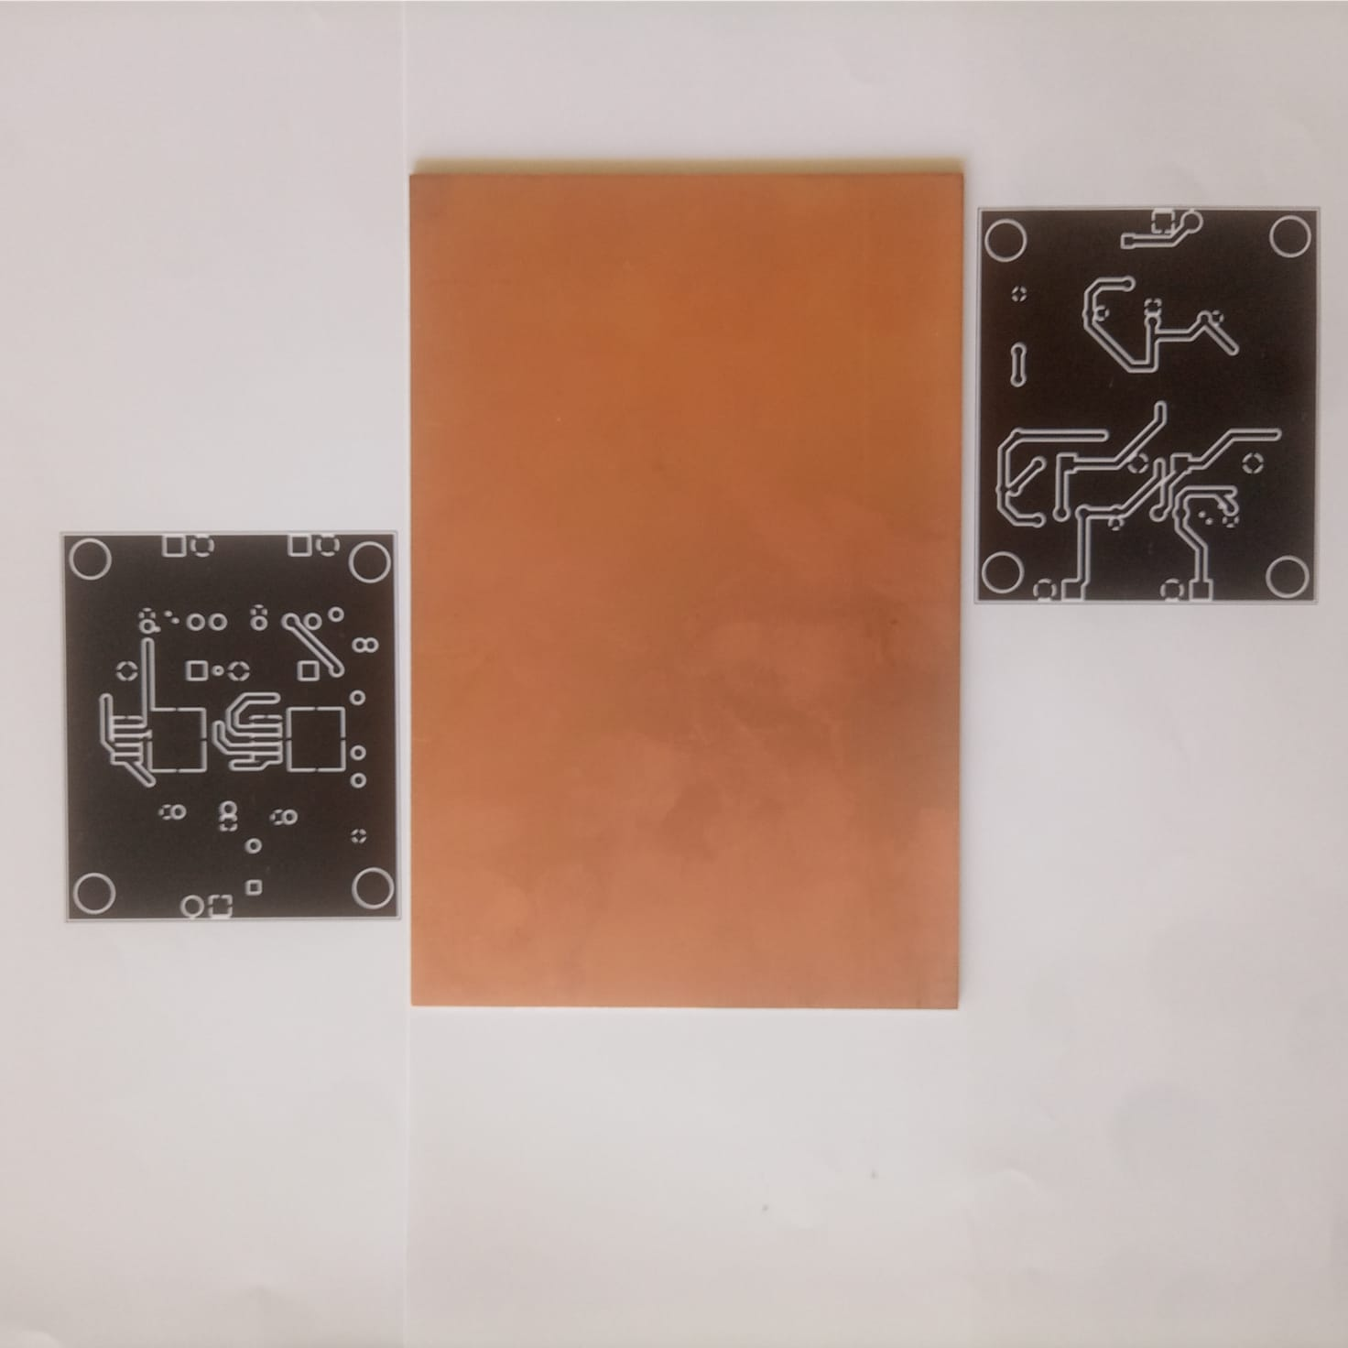
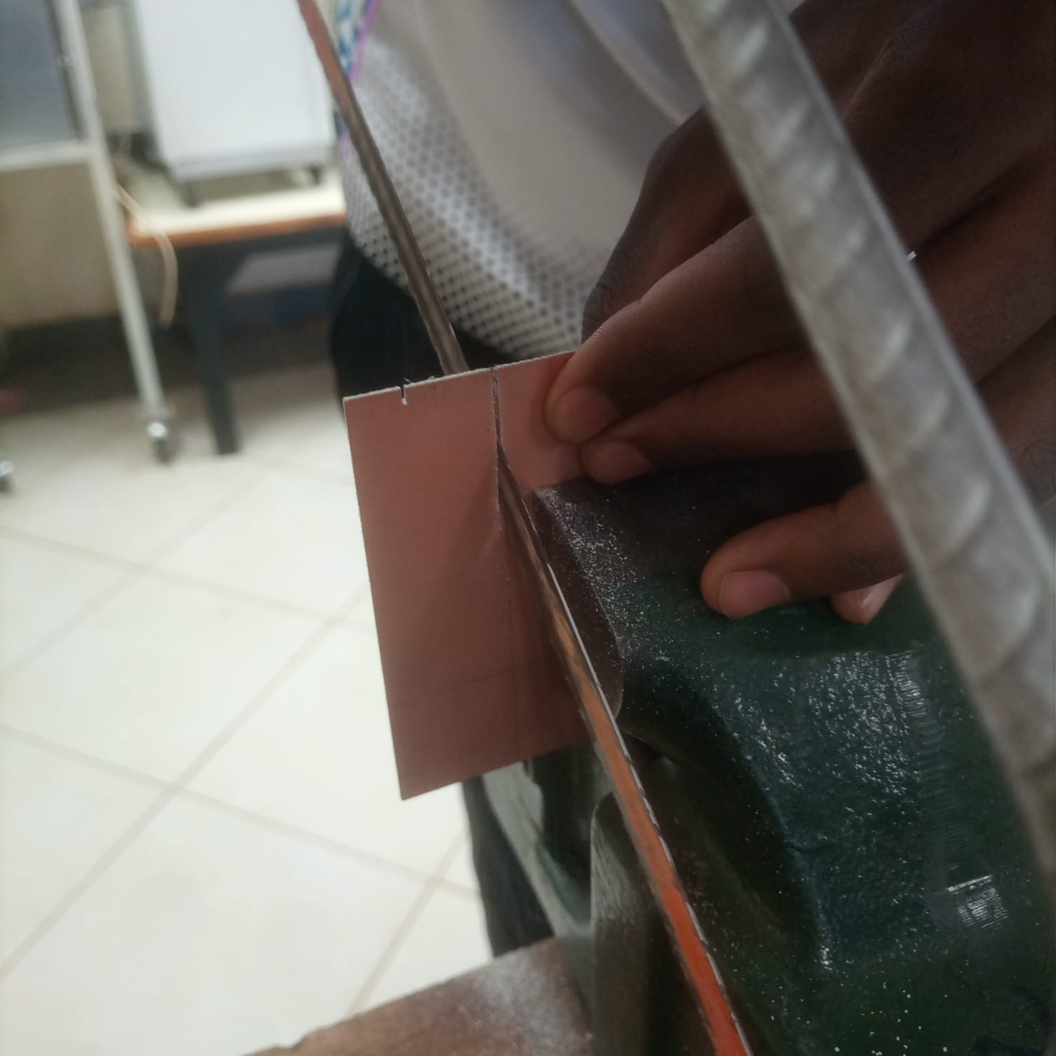
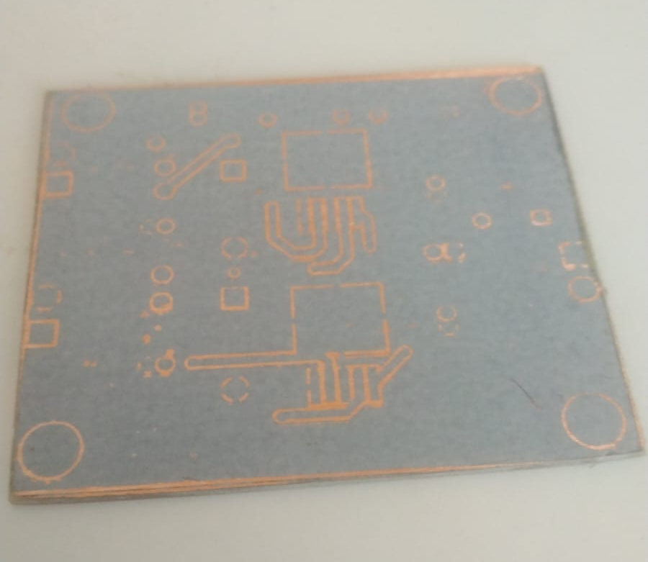
01
01
Print the board design
We used a Laser Printer to print our board design onto a sheet of magazine paper.
02
Sanding the copper clad
This is to allow for better adhesion of the toner to the copper
03
Transferring the toner
This was done by ironing the print on the copper clad.

Slide 7
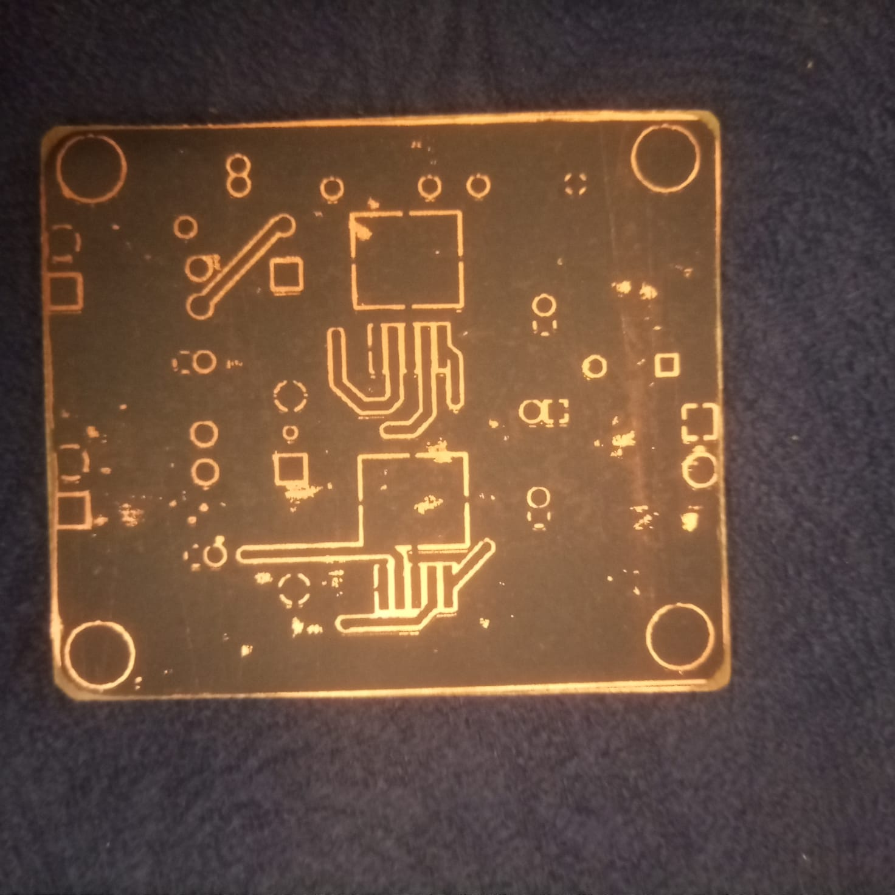
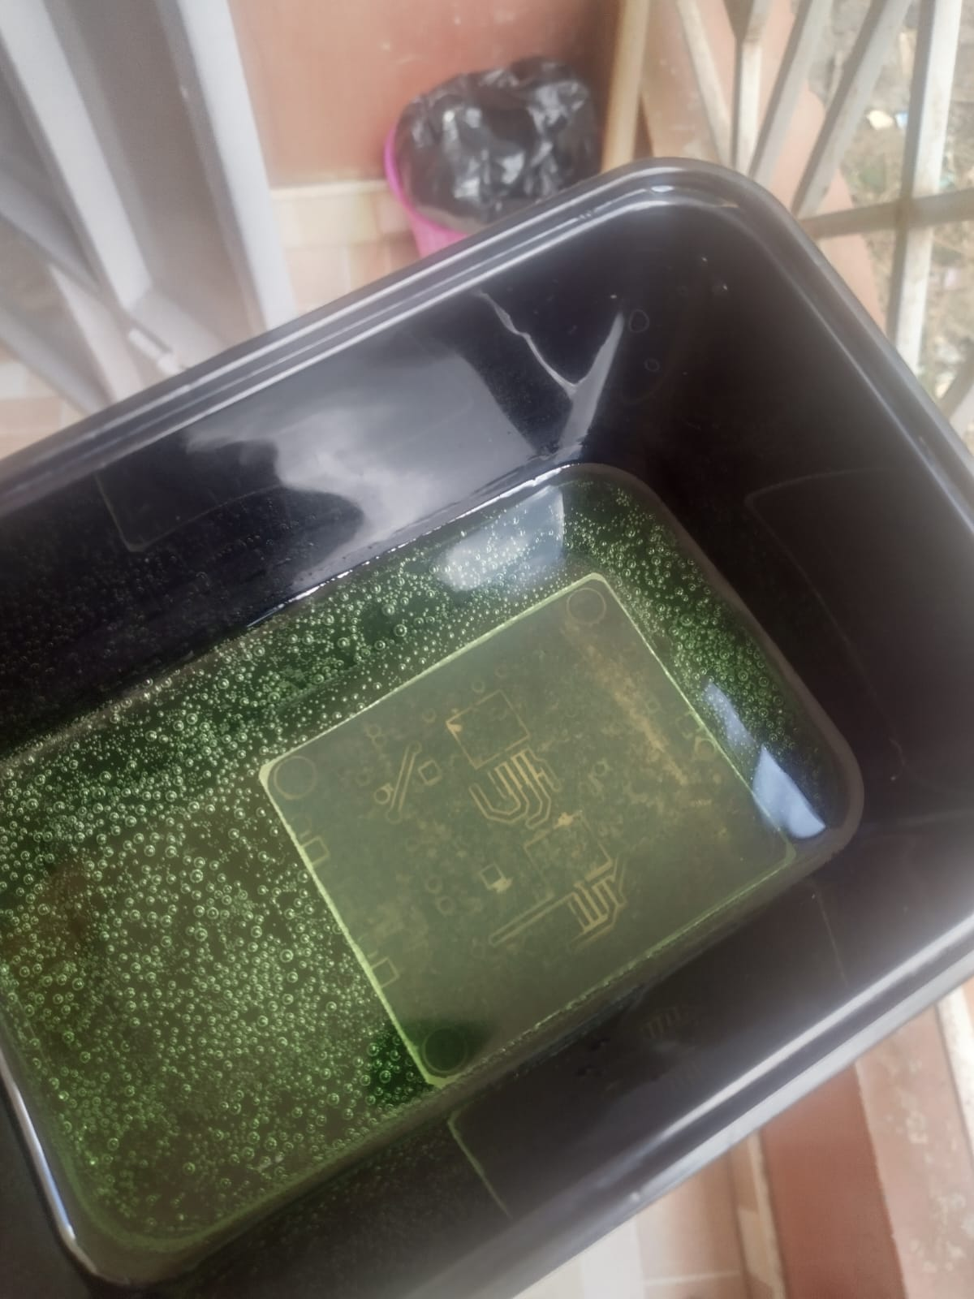
01
04
Dissolve the copper
This was done by mixing equal amount (100ml ) of hygogen peroxide and concentrated Hydochloric acid and dipping the copper clad in the solution.
The exposed copper part would dissolve in the solution leaving behind the inked tracks and ground pad.
05
Remove the ink
This was done by scraping off the ink with fine grit sand paper to re-expose the copper tracks and ground pad.

Slide 8
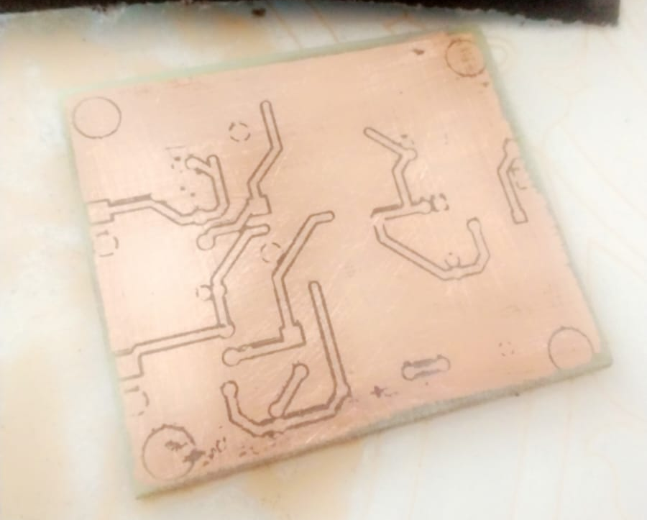
01
06
Drill through holes
This is done to place the components.
We reached this part only to find out we had made a slight mis-alignment error between the front and back layers.
07
Test tracks and solder parts
This is done to check for continuity of the tracks by using resistance testing.
After all is well , the components need to be soldered for further testing and eventual usage.

Slide 9
Assist navigation team build the tractor’s User Interface
We decided to hop onto the navigation team’s
tasklist as we await for the controller and it’s
peripherals from China.
03
We were able to come up with a user interface
to interact with the tractor as show in the next slide.

Slide 10
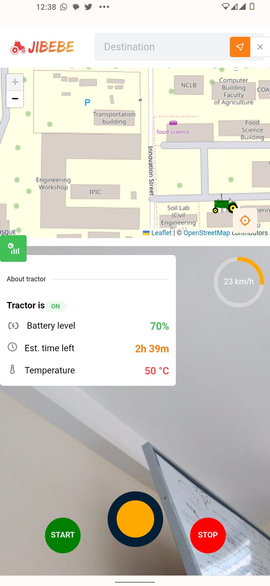
03
THE USER INTERFACE
Lists options of saved geofences on a database and create a route to that geofence’s first waypoint
See live preview here,
https://jibebe-webapp.vercel.app/
Mapview showing tractor’s realitme location using Leaflet JS library
Create geofence button. A geofence being a boounded geographic area eg. farm
Speed of tractor
Tractor parameters
Camera view for extra control of the tractor.
Joystick to control turn angle and speed.
Start tractor’s motor , enable controls
Stop tractor’s motor

Slide 11
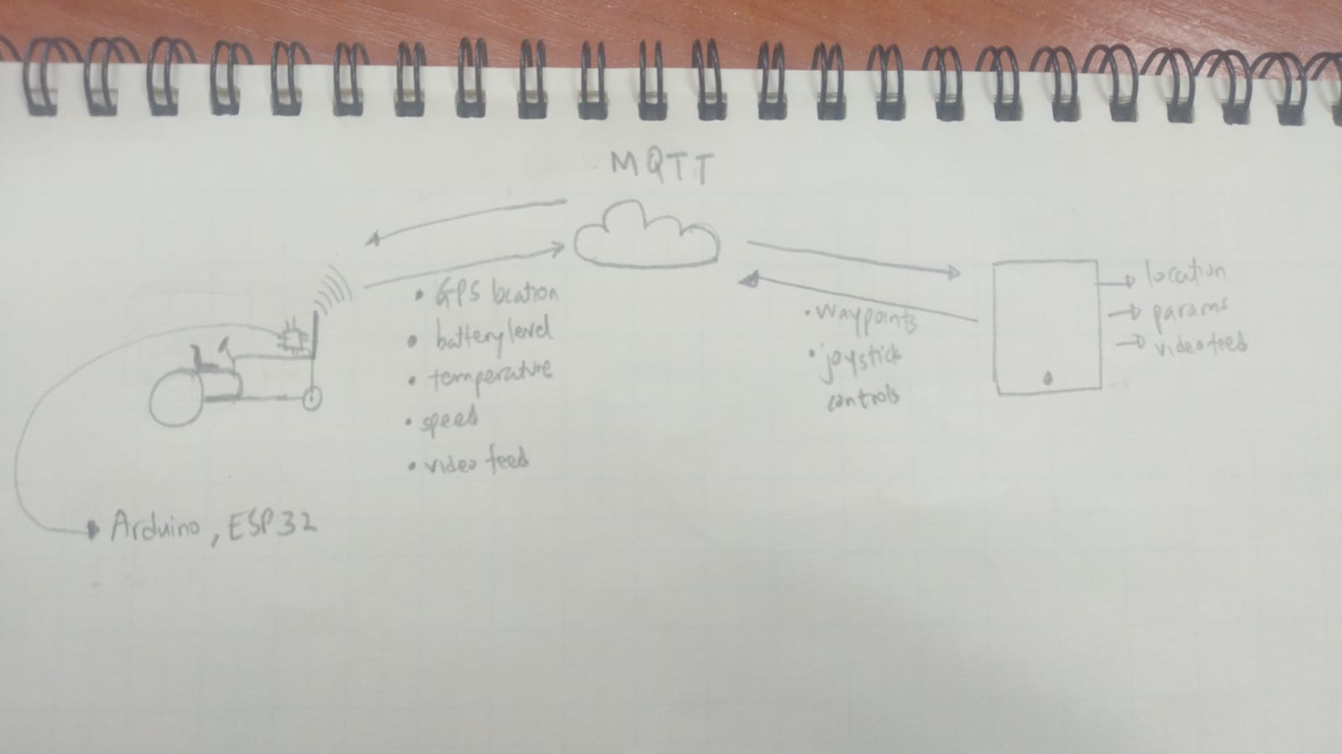
03
THE PLAN

Slide 12
THE END ,
THANK YOU!

Slide 13
Conclusion
We project that the buck converter will be fully
fabricated by the end of this week.
04
In addition , we are expecting the controller to
arrive on Monday next week.
We are also to further discuss with the navigation
team on building the UI

